Slide 1
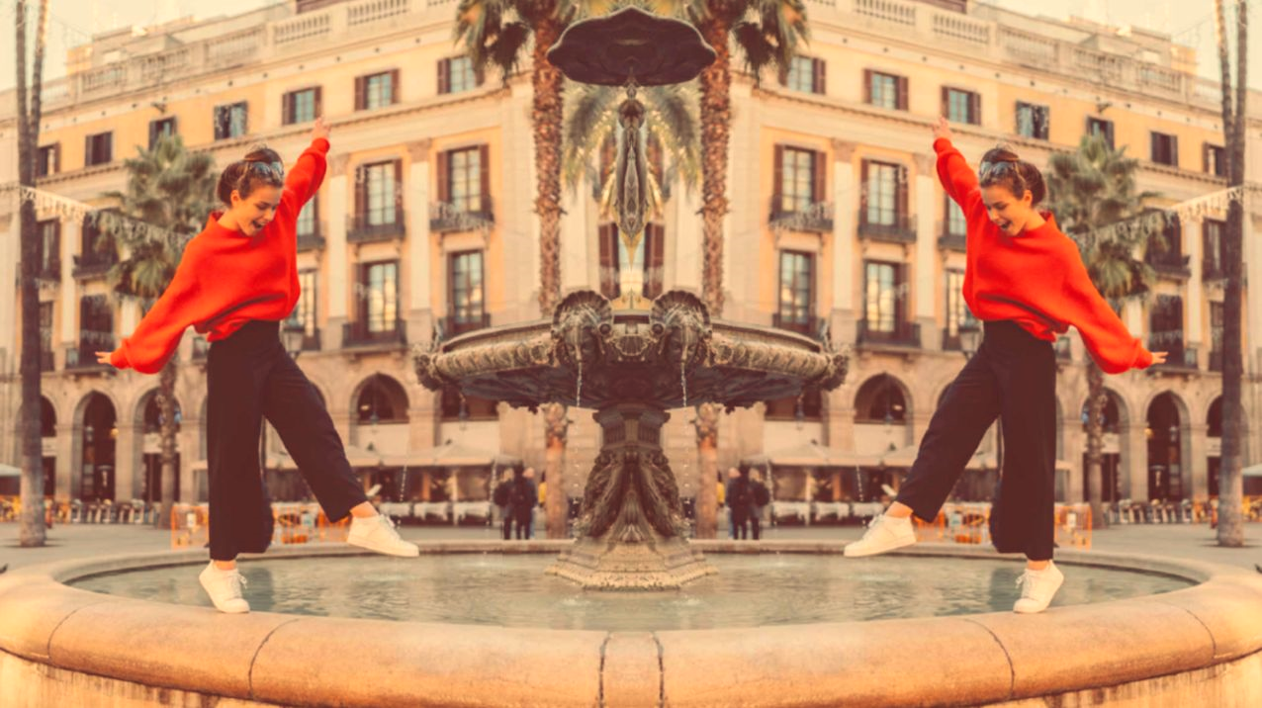
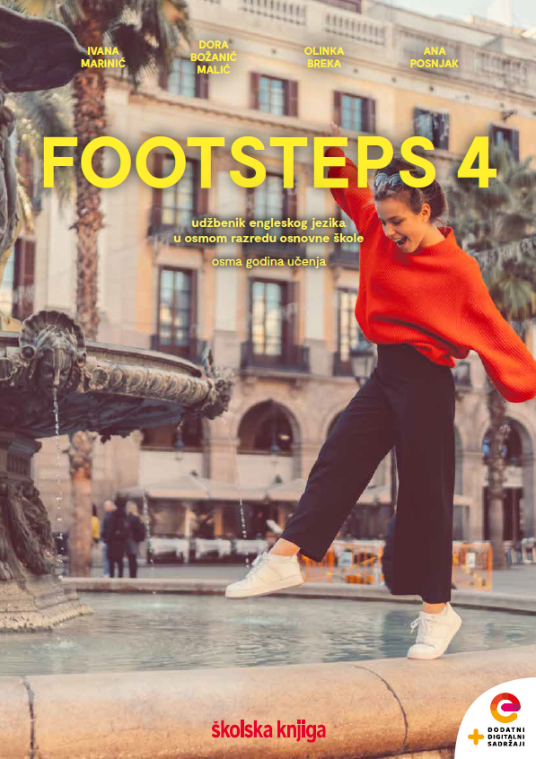

UNIT 1;
All too human
Lesson 5; Relationships

Slide 2
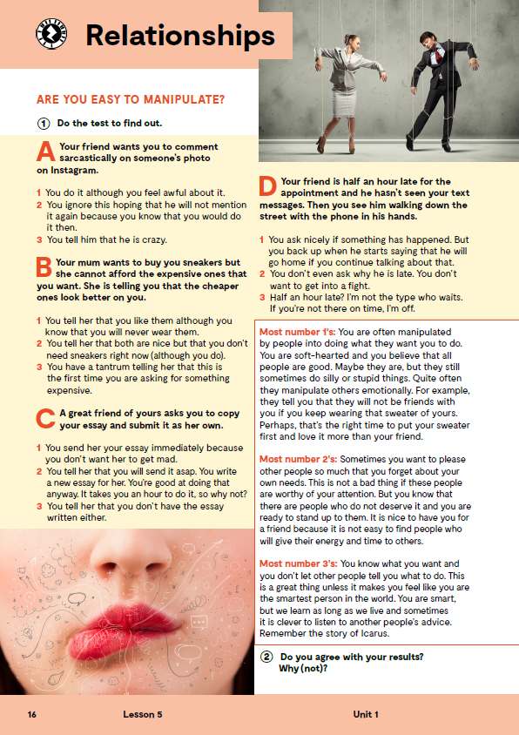
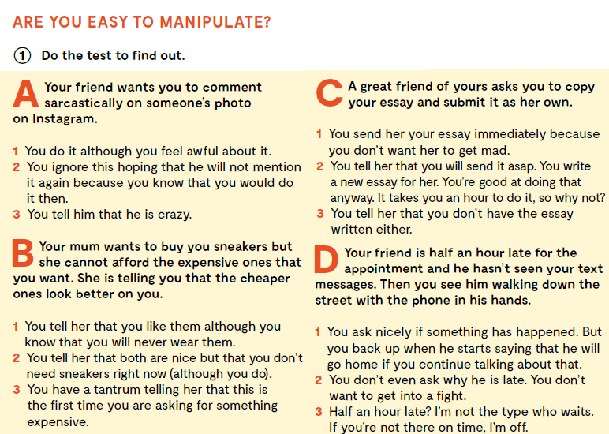
Are you easy to manipulate?
Mogu li ljudi tobom lako manipulirati?
RELATIONSHIPS
- veze, odnosi među ljudima
Do you know the meaning of these expressions?
Prepoznaješ li značenje ovih izraza?
nitpicking
invading
stereotyping
apologizing
a tantrum
to submit
asap
(as soon as possible)
to be soft-hearted
to be worthy of
someone’s attention
to stand up to
someone
being suspicious
Do the test to find out if are you easy to manipulate.
cjepidlačenje
napadati
stvarati stereotipe
ispričavati se
ispad gnjeva
predati
čim prije;
odmah, istog trena
biti mekog srca
biti vrijedan
nečije pažnje
usprotiviti se
nekome
biti sumnjičav

Slide 3

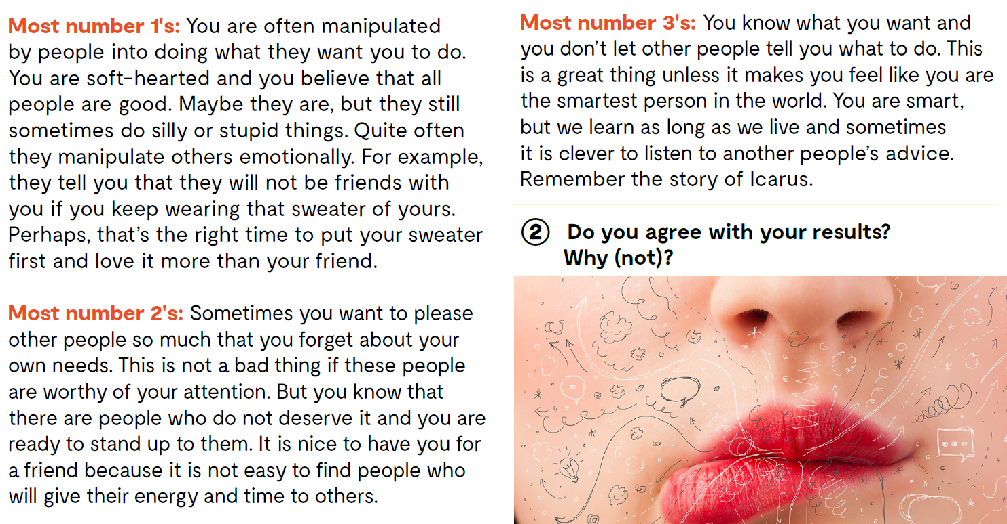
Check your answers.
Do you agree with your results? Why (not)?

Slide 4
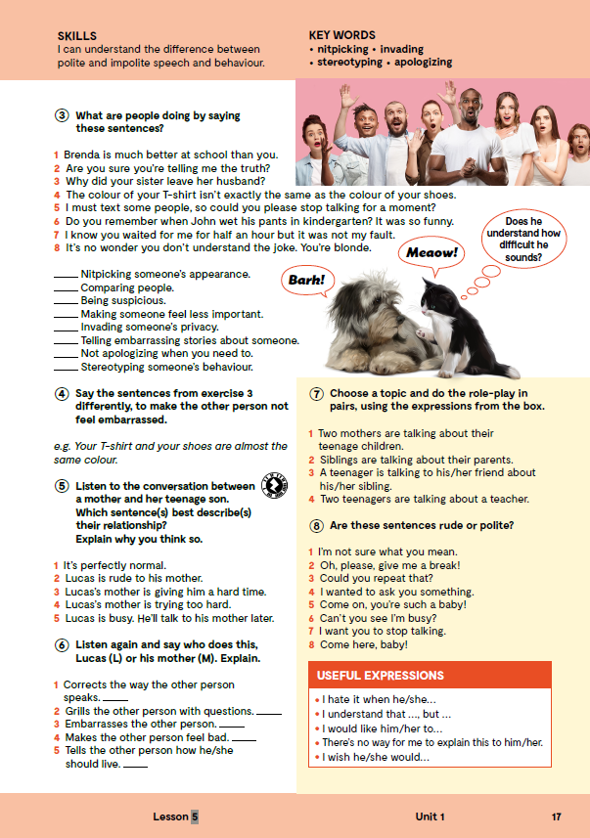
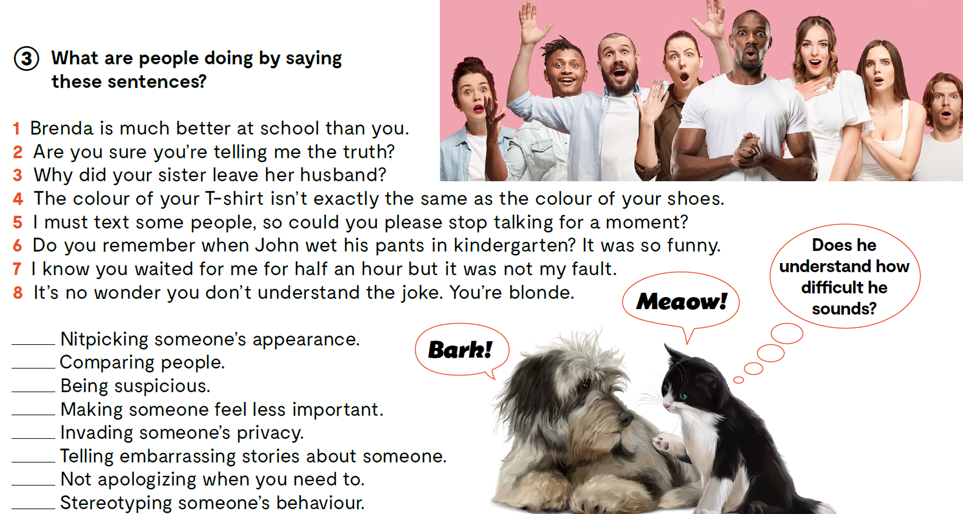
What are the people doing by saying these sentences?
4
1
2
5
3
6
7
8

Slide 5
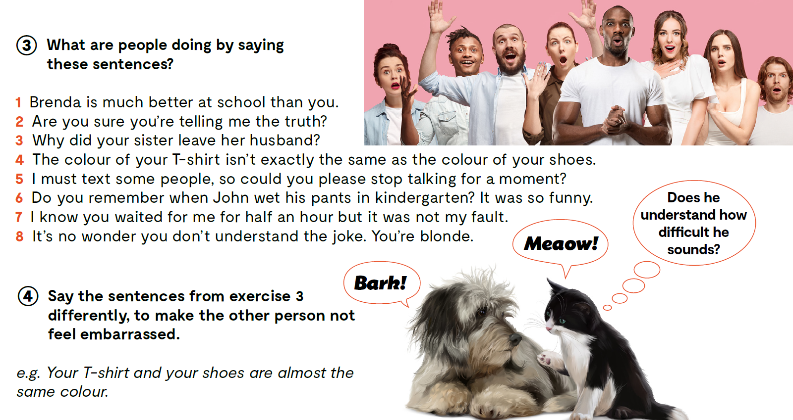
Say the sentences from exercise 3 differently, to make the other person not feel embarrassed.

Slide 6
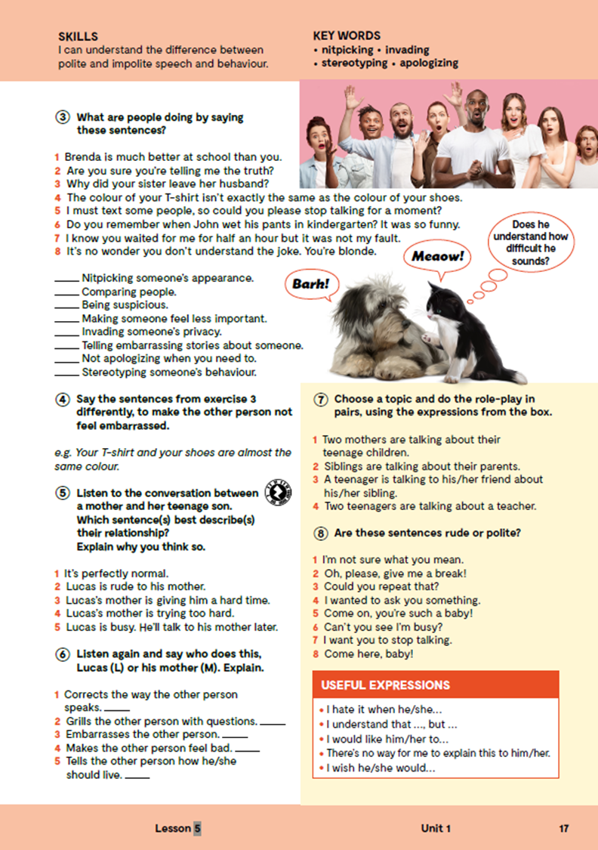

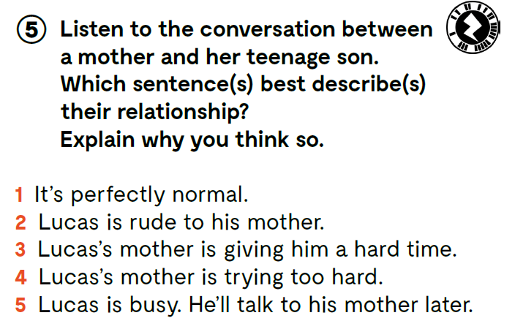
Listen to the conversation.
https://www.e-sfera.hr/dodatni-digitalni-sadrzaji/90ca172f-dd03-4574-95a6-c4617f1342f5/assets/audio/04_unit_1__lesson_5__exercises_5_7.mp3

Slide 7
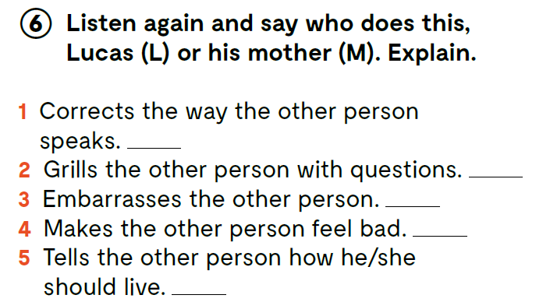
Listen again and say who does this, Lucas (L) or his mother (M). Explain.
https://www.e-sfera.hr/dodatni-digitalni-sadrzaji/90ca172f-dd03-4574-95a6-c4617f1342f5/assets/audio/04_unit_1__lesson_5__exercises_5_7.mp3
L
M
M
M
M

Slide 8
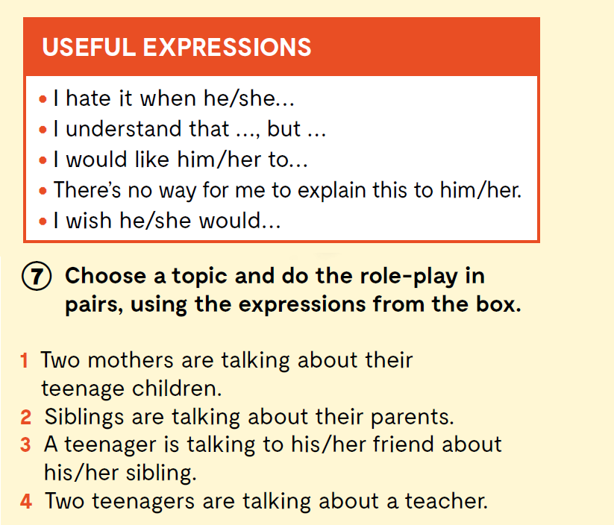
Choose a topic and do the role-play in pairs, using the expressions from the box.

Slide 9
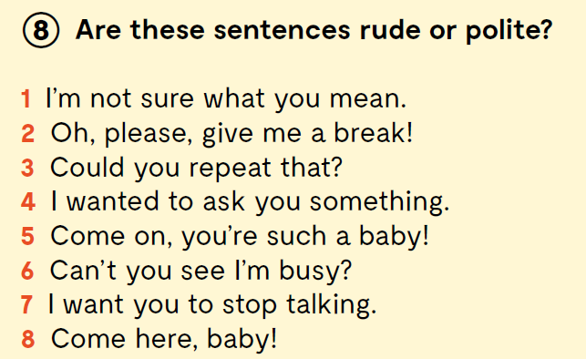
Are these sentences rude or polite?
Check the link to practice
https://wordwall.net/play/11693/193/879
https://www.bookwidgets.com/play/RB6LNRQ

Slide 10
Where can you hear these sentences?
When can you hear them?
Who says them? Why?
How do you feel when you hear something like that?
How do you feel when you say something like that?

Slide 11
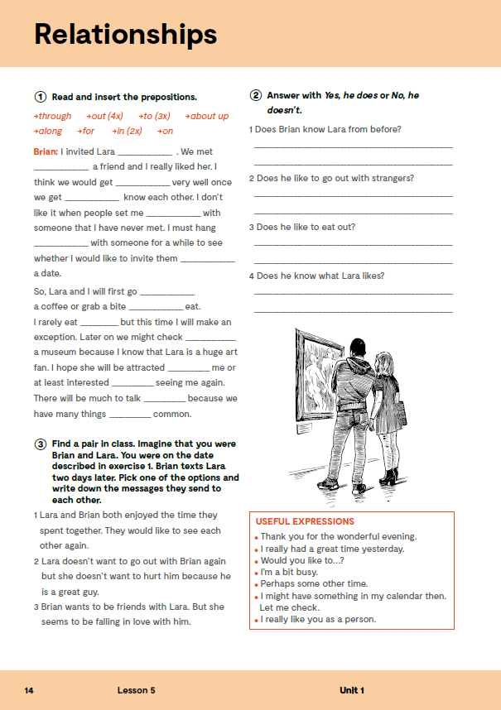
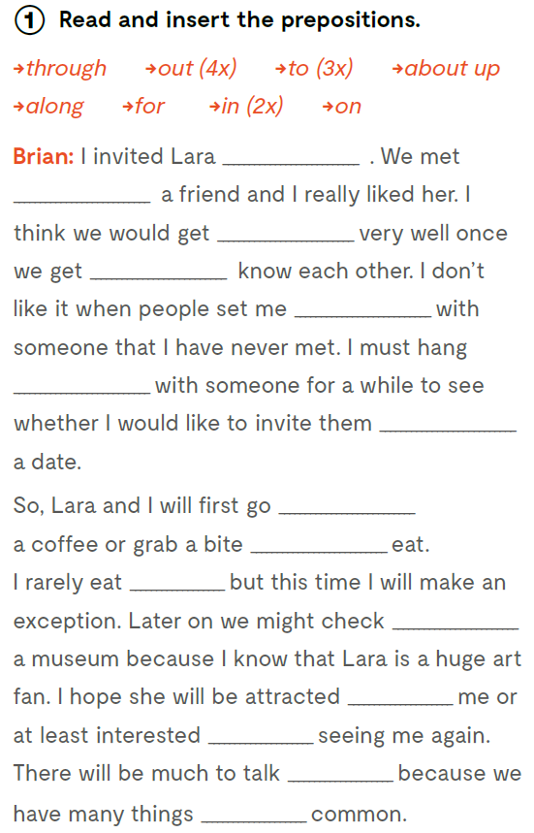
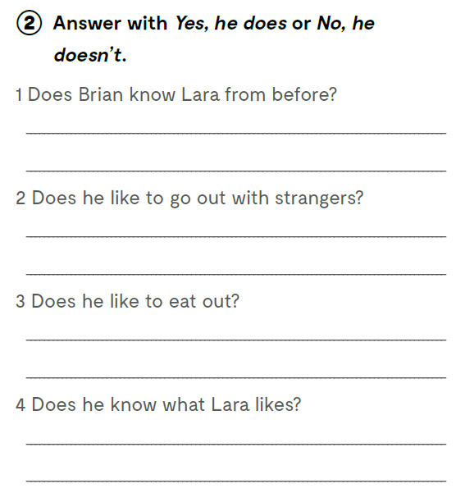
Open your exercise book, page 14.
|
Read and insert the prepositions.
out
through
Answer with Yes, he does or No, he doesn’t.
along
to
up
out
Do sad smo promišljali o odnosima između roditelja i djece, braće i sestara te prijatelja. A sada razmislite o drugoj vrsti odnosa – o ljubavi.
Yes, he does.
on
for
No, he doesn’t.
to
out
out
No, he doesn’t.
to
in
about
Yes, he does.
in

Slide 12

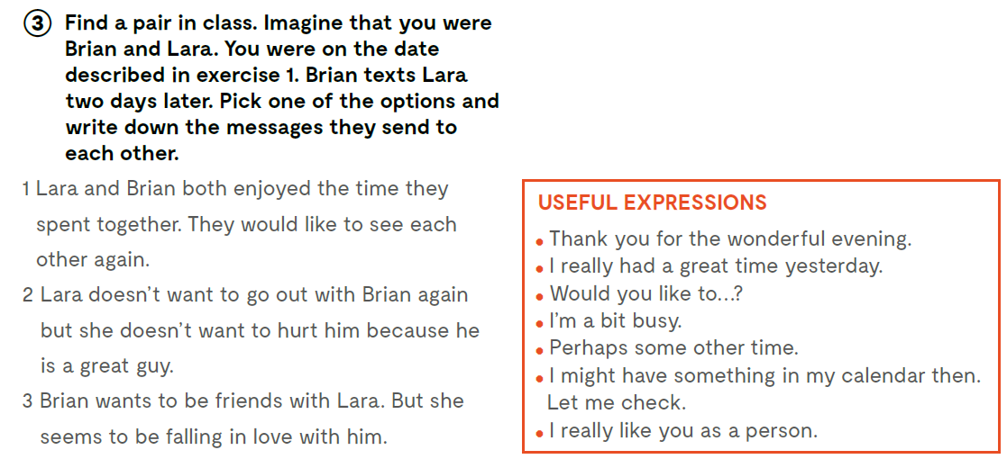
Find a pair in class. Imagine that you were Brian and Lara. You were on the date described in exercise 1. Brian texts Lara two days later. Pick one of the options and write down the messages they send to each other.

Slide 13
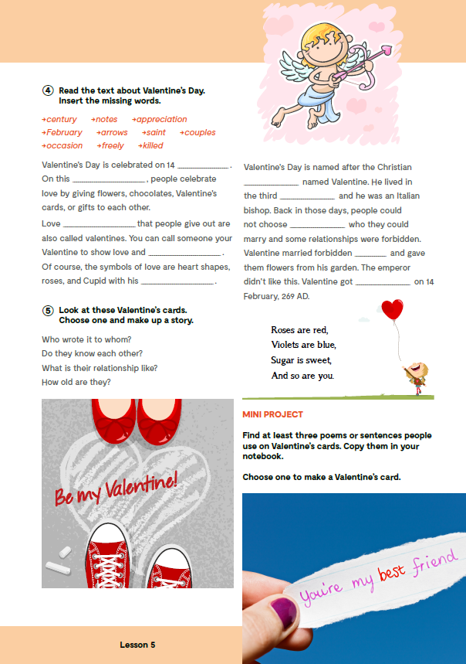
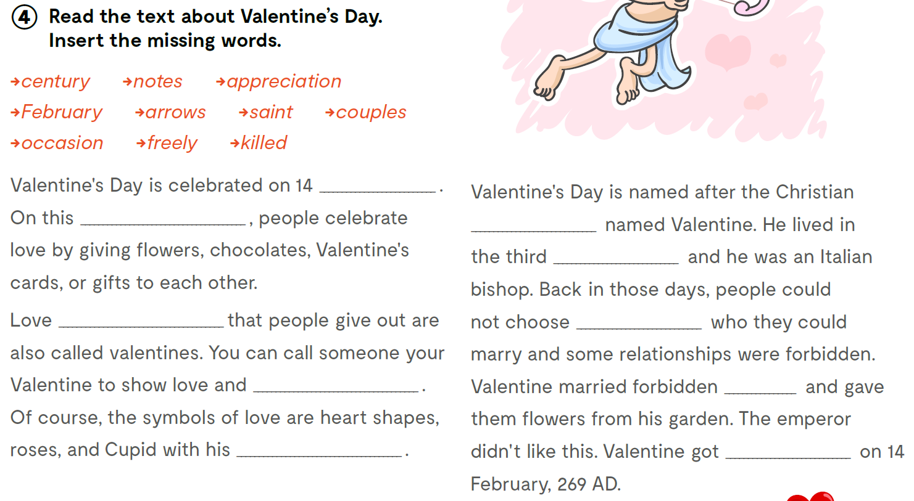
On the next page, page 15.
Read the text about Valentine’s Day. Insert the missing words.
stoljeće
poruke
zahvalnost
veljača
strijele
sveti
parovi
prigoda
slobodno
ubijen
February
occasion
saint
century
notes
freely
appreciation
couples
arrows
killed

Slide 14

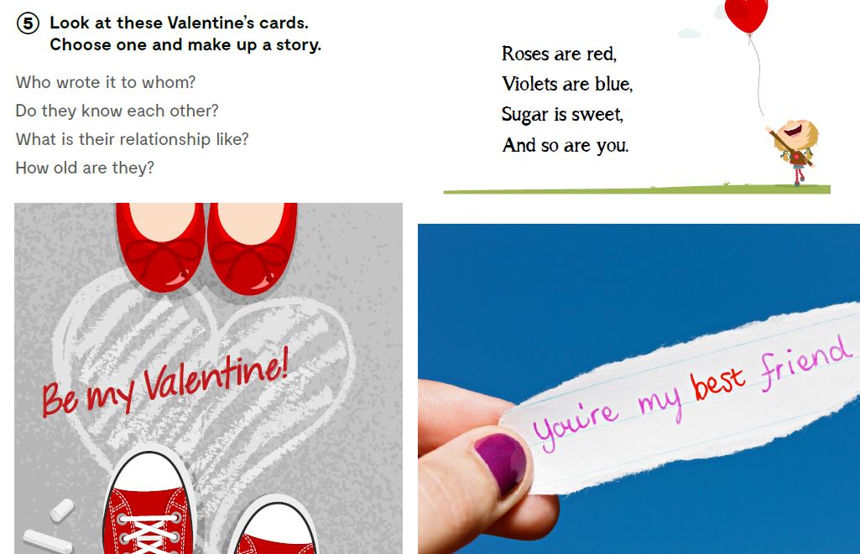
Look at these Valentine’s cards. Choose one and make up a story.
Odaberi jednu od čestitki za Valentinovo i osmisli priču.
Who wrote it to whom? Tko je čestitku poslao kome?
Do they know each other? Znaju li se?
What is their relationship like?
Kakva je njihova veza?
How old are they?
Koliko su stari?

Slide 15
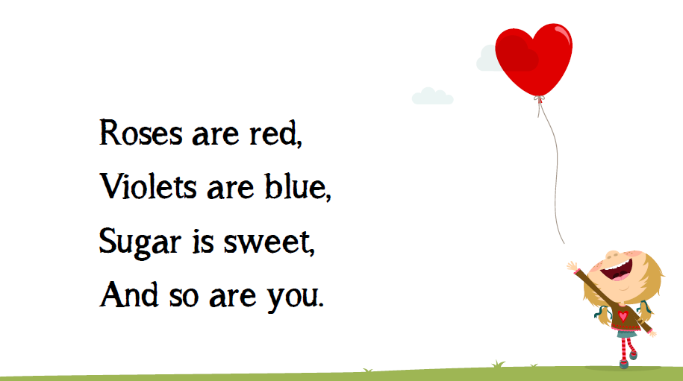
Roses are red, pizza is too,
I ordered a large one and
I’m sharing it with you.
Roses are red, violets are blue,
I bet my bike is faster than you.
Roses are red, violets are blue,
I bet I can dance better than you.

Slide 16
